Slide 1
Team Malak
Josh Halat
Lucas Radke
Jordan Shostak Kaitlin Wheeler

Slide 2
Sprint Accomplishments
Designed and set up a database for patient and provider info
Created a login view for all users
Created a patient creation view for admin use
Logan

Slide 3
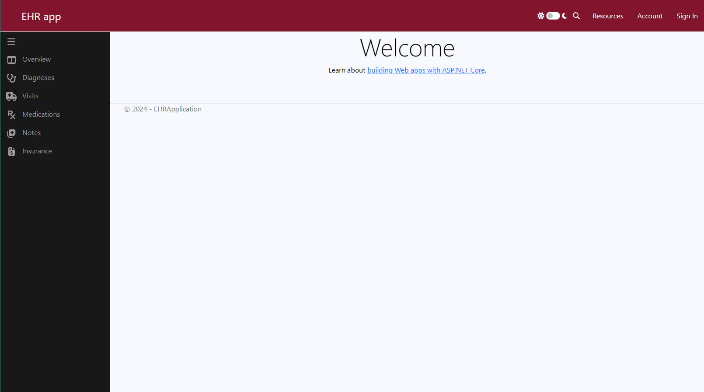
Live Demo
Austin

Slide 4
Sprint Goals
Finish implementing CRUD operations
Update database with additional tables
Complete input validation process for new data
Kaitlin

Slide 5
Review
Designed and created the database
Created the project theme
Created views for users to login and for admins to create new patients
Austin

Slide 6
Questions?
Austin

